Slide 1
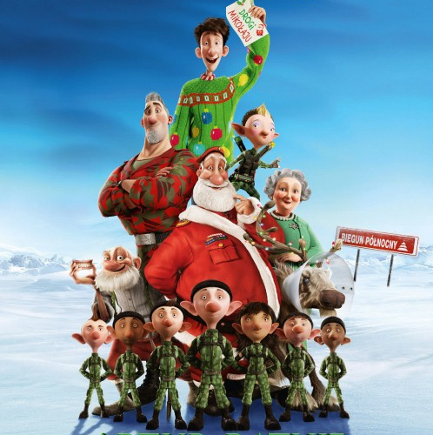
https://www.youtube.com/watch?v=Szgq991TjPw

Slide 2
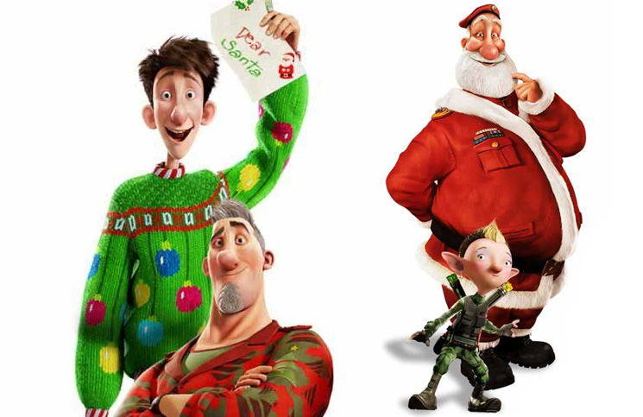
Artur???
R O B I
Co

